Slide 1

Diffusion Model
Denoising Diffusion Probabilistic Models
What is the diffusion model?
How to visualize the Diffusion model?
How to derive the diffusion model mathematically?
Haruko386
Notes:
啊啊啊啊，数学为什么这么坏 (；′⌒`)

Slide 2
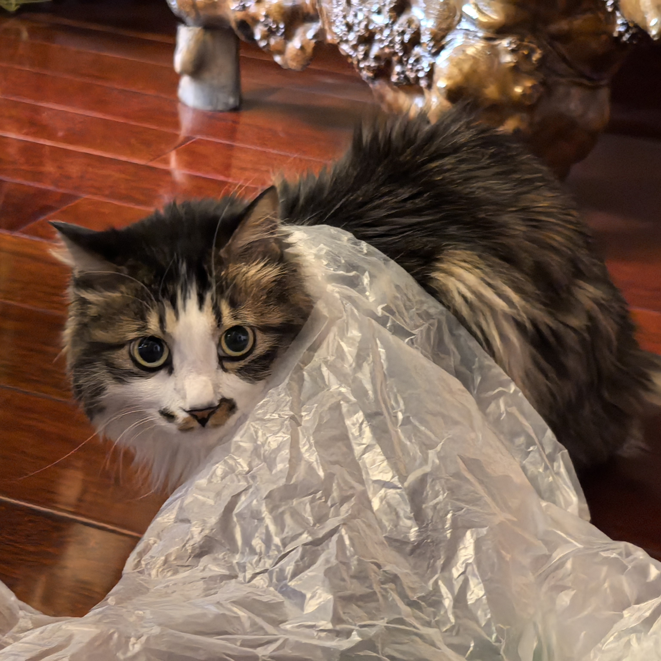
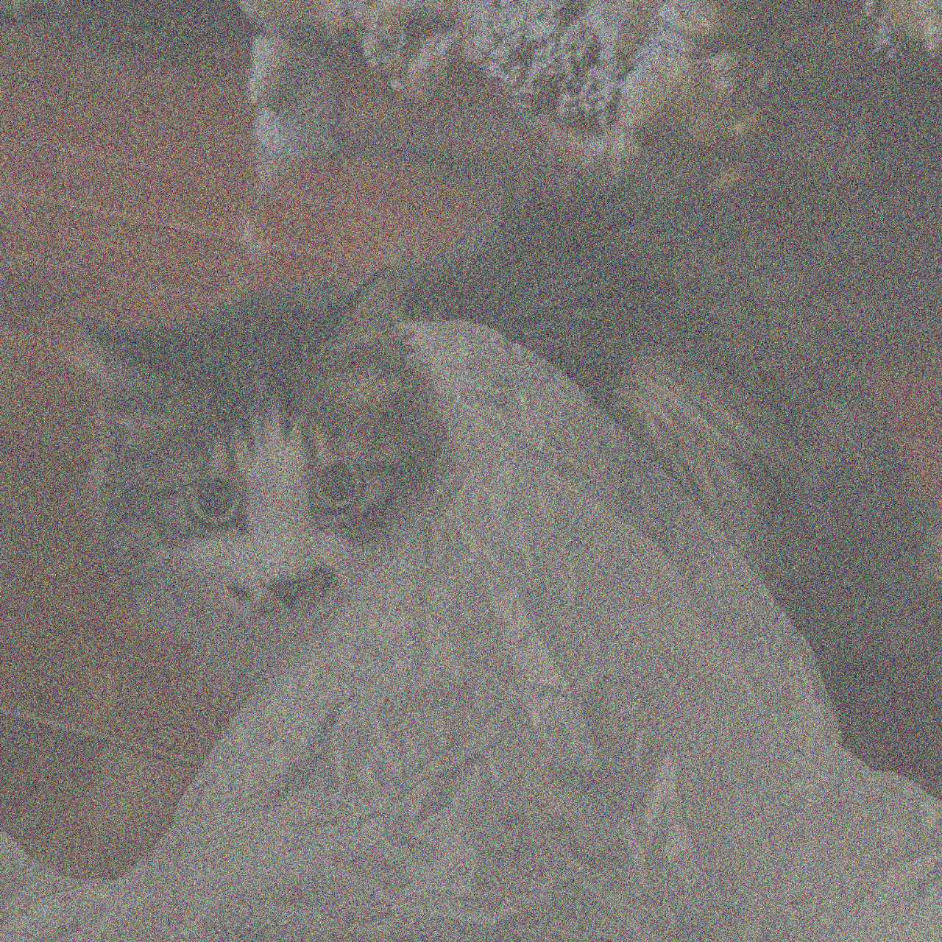
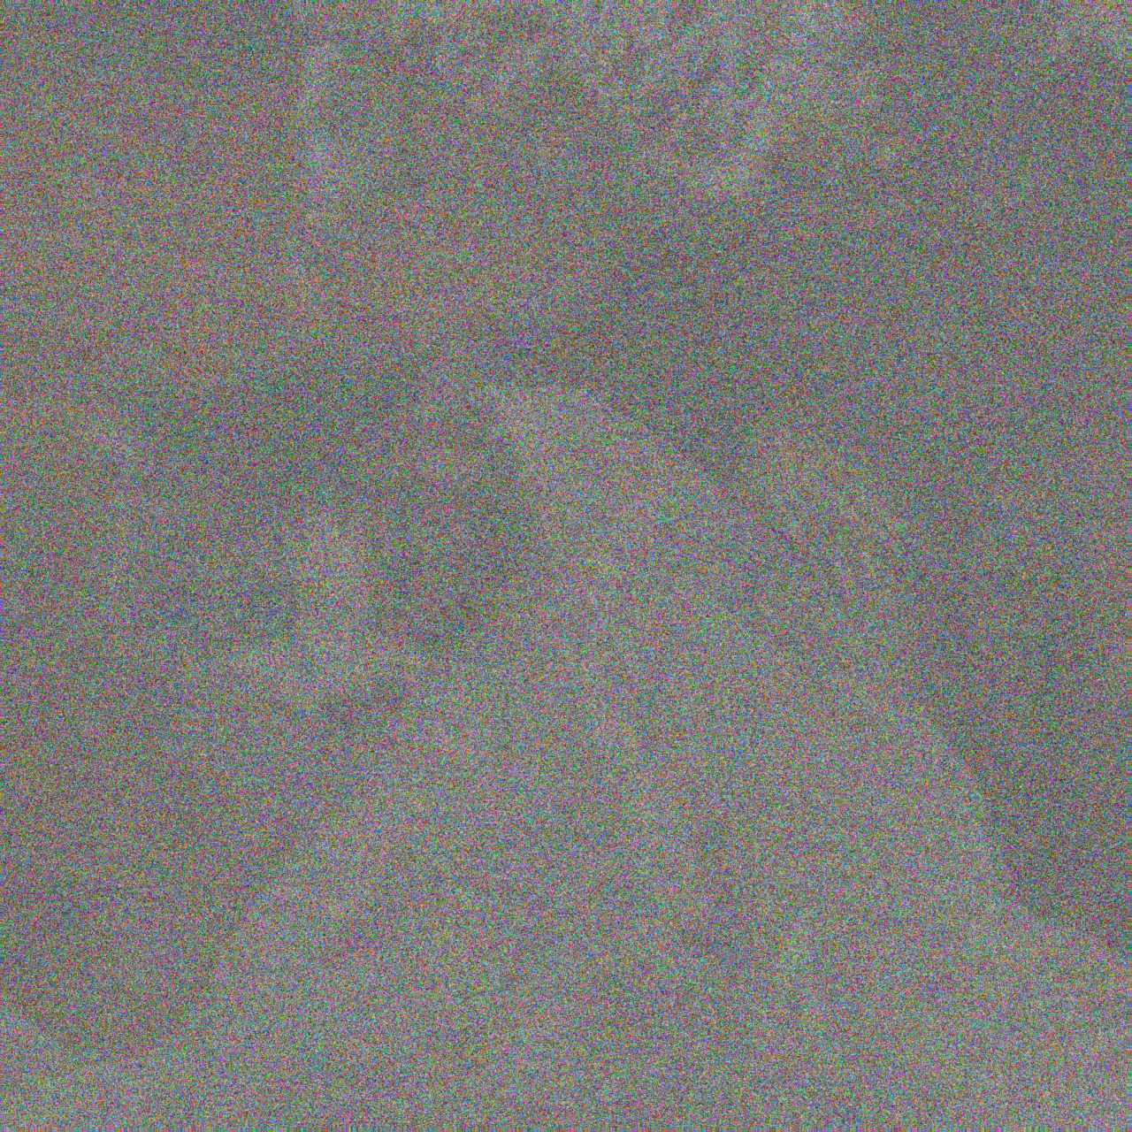

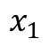
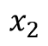
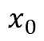
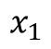
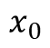
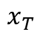
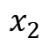
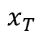
Diffusion Model
Denoising Diffusion Probabilistic Models^{[1]}
Forward Diffusion Process
Data
Noise
$$x_{0}$$
$$x_{1}$$
$$x_{2}$$
$$x_{T}$$
Reverse Diffusion Process
Data
Noise
$$x_{0}$$
$$x_{1}$$
$$x_{2}$$
$$x_{T}$$
[1] Ho J, Jain A, Abbeel P. Denoising diffusion probabilistic models. NeuraIPS, 2020.

Slide 3

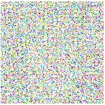

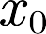
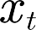

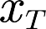



Diffusion Model
Data
+
Noise
+
+
Data
Noise
-
Model
（t）
Denoise Process

Slide 4
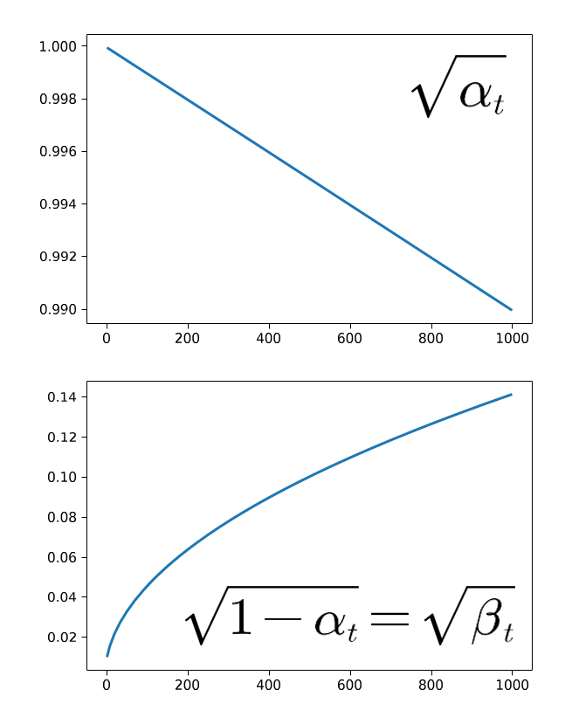
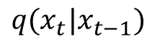
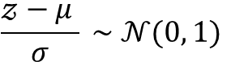
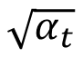
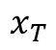
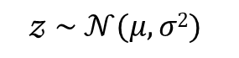
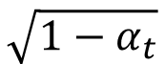
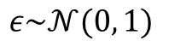
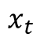
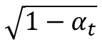
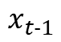
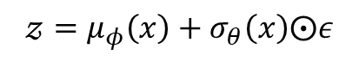
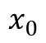
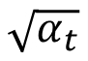
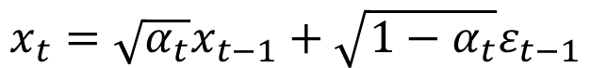
Forward Diffusion Process
$$q(x_{t}|x_{t−1})$$
Data
Noise
+
Gauss distribution
+
$$x_{0}$$
$$x_{t−1}$$
$$\sqrt{{1−α}_{t}}$$
$$x_{t}$$
$$x_{T}$$
$$\sqrt{α_{t}}$$
+
The reparameterization trick
$$𝓏 \sim 𝒩(μ, σ2)$$
$$\sqrt{α_{t}}$$
$$\sqrt{{1−α}_{t}}$$
$$\frac{𝓏−μ }{σ} \sim 𝒩(0, 1)$$
gaussian
signal
noise
$$𝓏=μ_{φ}\left(x\right)+σ_{θ}\left(x\right)⨀ε$$
$$x_{t}=\sqrt{α_{t}}x_{t−1}+\sqrt{{1−α}_{t}}ε_{t−1}$$
$$ε\sim 𝒩(0, 1)$$
$$q\left(x_{t} | x_{t−1}\right)=𝒩(x_{t};\sqrt{α_{t}}x_{t−1},({1−α}_{t})Ι)$$
mean
variance
Notes:
并不是简单的加一个高斯噪声，而是通过一个线性组合的方式加噪
Q这个加噪过程符合一个高斯分布

Slide 5
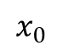
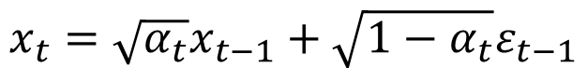
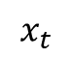
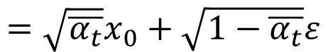
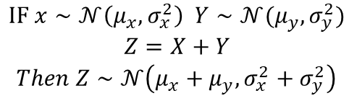
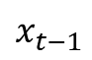
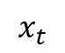
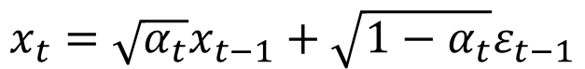
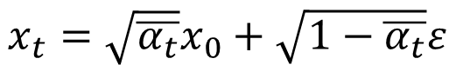
Forward Diffusion Process
① forward (close-form)
$$x_{t}=\sqrt{α_{t}}x_{t−1}+\sqrt{1−α_{t}}ε_{t−1}$$
Noise
$$x_{t−1}$$
$$x_{t}$$
$$=\sqrt{α_{t}}(\sqrt{α_{t−1}}x_{t−2}+\sqrt{1−α_{t−1}}ε_{t−2})+\sqrt{1−α_{t}}ε_{t−1}$$
$$x_{t}=\sqrt{α_{t}}x_{t−1}+\sqrt{1−α_{t}}ε_{t−1}$$
$$=\sqrt{α_{t}α_{t−1}}x_{t−2}+(\sqrt{α_{t}−{α_{t}α}_{t−1}}ε_{t−2}+\sqrt{1−α_{t}}ε_{t−1})$$
$$IF x∼𝒩\left(μ_{x},σ_{x}^{2}\right) Y∼𝒩(μ_{y},σ_{y}^{2})$$
$$Z=X+Y$$
$Then Z$ $∼𝒩\left(μ_{x}+μ_{y},σ_{x}^{2}+σ_{y}^{2}\right)$
···
Noise
$$=\sqrt{α_{t}α_{t−1}···α_{1}α_{0}}x_{0}+\sqrt{1−{α_{t}α}_{t−1}···α_{1}}ε$$
$$x_{0}$$
$$x_{t}$$
$$x_{t}=\sqrt{\overline{α_{t}}}x_{0}+\sqrt{1−\overline{α_{t}}}ε$$
$$=\sqrt{\overline{α_{t}}}x_{0}+\sqrt{1−\overline{α_{t}}}ε$$

Slide 6
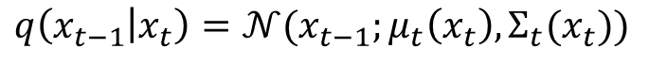
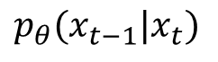
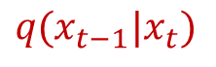
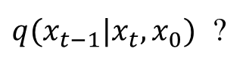
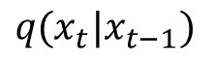
Reverse Diffusion Process
Markov
$$q(x_{t}|x_{t−1})$$
Data
Noise
+
+
$$q(x_{t−1}|x_{t})$$
impossible!
$q(x_{t−1}|x_{t},x_{0})$ ?
$$p_{θ}(x_{t−1}|x_{t})$$
Neural Network
Assume: the output is gaussian
Target Distribution
$$q\left(x_{t−1} | x_{t}\right)=𝒩(x_{t−1};μ_{t}\left(x_{t}\right),Σ_{t}(x_{t}))$$
Approximated Distribution
$$p_{θ}\left(x_{t−1} | x_{t}\right)=𝒩(x_{t−1};μ_{θ}\left(x_{t},t\right),Σ_{θ}\left(xt,t\right))$$

Slide 7
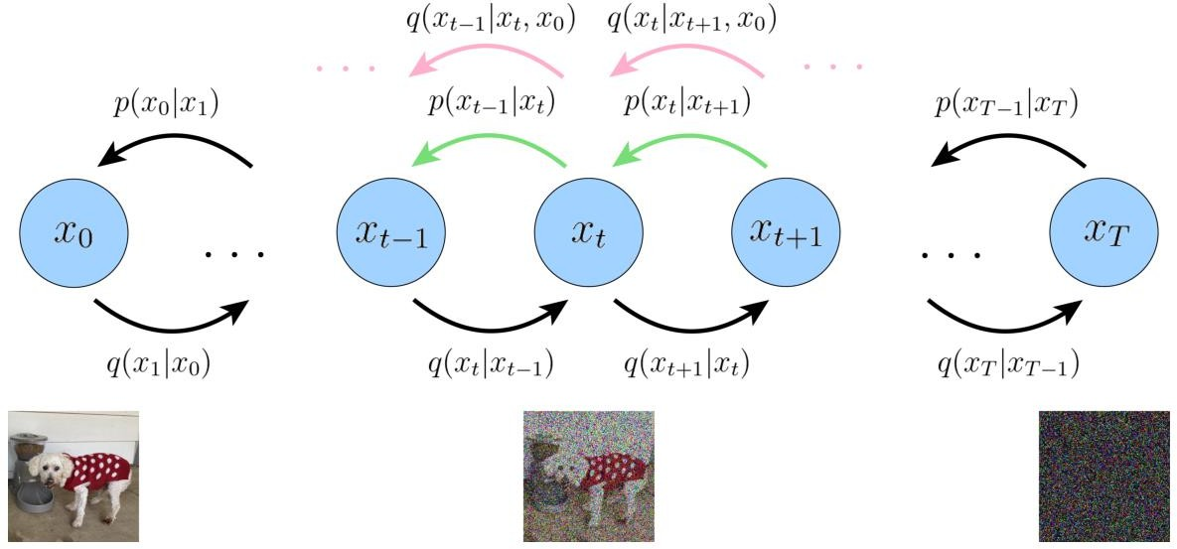
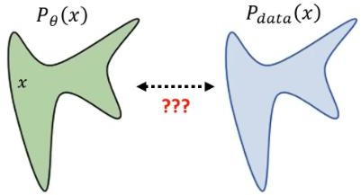
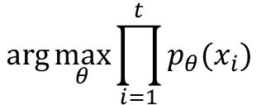
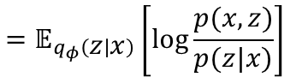
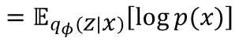
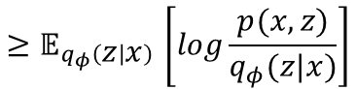






Maximum Likelihood Estimation
[1]
$$\arg{\max_{θ}{\prod_{i=1}^{t}{p_{θ}(x_{i})}}}$$
$$\arg{\max_{θ}{\sum_{i=1}^{t}{\log{p_{θ}(x_{i})}}}}$$
② optimization (view 1)
$$\log{p(x)}=\log{p(x)\int{q_{φ}\left(z|x\right) dz}}$$
$$=\int{q_{φ}\left(z|x\right)(\log{P(x)}) dz}$$
KL Divergence always ≥ 0
$$=𝔼_{q_{φ}\left(z | x\right)}\left[\log{\frac{p(x,z)}{p(z|x)}}\right]$$
$$=𝔼_{q_{φ}\left(z | x\right)}\left[\log{p(x)}\right]$$
$$=𝔼_{q_{φ}\left(z | x\right)}\left[\log{\frac{p\left(x,z\right)}{q_{φ}\left(z | x\right)}}\right]+D_{KL}\left(q_{φ}\left(z | x\right) || p(z|x)\right)$$
$$=𝔼_{q_{φ}\left(z | x\right)}\left[\log{\frac{p(x,z)q_{φ}\left(z | x\right)}{p(z|x)q_{φ}\left(z | x\right)}}\right]$$
$$=𝔼_{q_{φ}\left(z | x\right)}\left[\log{\frac{p(x,z)}{q_{φ}(z|x)}}\right]+𝔼_{q_{φ}\left(z | x\right)}\left[\log{\frac{q_{φ}\left(z | x\right)}{p(z|x)}}\right]$$
$${≥𝔼}_{q_{φ}\left(z | x\right)}\left[log\frac{p(x,z)}{q_{φ}(z|x)}\right]$$
ELBO
[1] Luo C. Understanding diffusion models: A unified perspective[J]. arXiv preprint arXiv:2208.11970, 2022.
Notes:
找到某一参数，使得模型生成的图像是正确的概率是比较高的
画图来说就是拟合每一步的分布

Slide 8














What is $q(x_{t−1}|x_{t},x_{0})$
If we know
$$x_{0}$$
and
$$x_{t}$$
？
$$q\left(x_{t−1} | x_{t},x_{0}\right)$$
is deterministic
Assume: Markov
$$q\left(x_{t−1} | x_{t},x_{0}\right)=\frac{q(x_{t−1},x_{t},x_{0})}{q(x_{t},x_{0})}=\frac{q\left(x_{t} | x_{t−1}\right)q\left(x_{t−1} | x_{0}\right)q(x_{0})}{q\left(x_{t} | x_{0}\right)q(x_{0})}=\frac{q\left(x_{t} | x_{t−1}\right)q(x_{t−1}|x_{0})}{q(x_{t}|x_{0})}$$
$$q(x_{t}|x_{t−1})∼𝒩(x_{t};\sqrt{α_{t}}x_{t−1}, 1−α_{t})$$
$$\sqrt{α_{t}}$$
$$\sqrt{{1−α}_{t}}$$
$$q(x_{t−1}|x_{0})∼𝒩(x_{t−1};\sqrt{{\overline{α}}_{t−1}}x_{0}, 1−{\overline{α}}_{t−1})$$
$$\sqrt{{\overline{α}}_{t−1}}$$
$$\sqrt{1−{\overline{α}}_{t−1}}$$
$$q(x_{t}|x_{0})∼𝒩(x_{t};\sqrt{\overline{α_{t}}}x_{0}, 1−\overline{α_{t}})$$
$$\sqrt{\overline{α_{t}}}$$
$$\sqrt{1−\overline{α_{t}}}$$

Slide 9





What is $q(x_{t−1}|x_{t},x_{0})$
③ reverse
If we know $x_{0}$
$$q(x_{t}|x_{t−1})∼𝒩(x_{t};\sqrt{α_{t}}x_{t−1}, 1−α_{t})$$
$$q\left(x_{t−1} | x_{t},x_{0}\right)∝𝒩(x_{t−1};\frac{\sqrt{α_{t}}\left(1−\overline{α_{t−1}}\right)x_{t}+\sqrt{{\overline{α}}_{t−1}}\left(1−α_{t}\right)x_{0}}{1−\overline{α_{t}}},\frac{(1−α_{t})(1−{\overline{α}}_{t−1})}{1−{\overline{α}}_{t}}Ι)$$
$$q(x_{t−1}|x_{0})∼𝒩(x_{t−1};\sqrt{{\overline{α}}_{t−1}}x_{0}, 1−{\overline{α}}_{t−1})$$
$$q(x_{t}|x_{0})∼𝒩(x_{t};\sqrt{\overline{α_{t}}}x_{0}, 1−\overline{α_{t}})$$
$$μ_{q}(x_{t},t)$$
$$Σ_{q}(t)$$
Assume: fixed
Minimize the distance between two Gaussian distributions
Notes:
我们需要拟合两个分布，一个是我们预先定义好的加噪分布，另一个为上述的去噪过程的分布

Slide 10









Remove $x_{0}$
③ reverse
If we know $x_{0}$
$$q\left(x_{t−1} | x_{t},x_{0}\right)∝𝒩(x_{t−1};\frac{\sqrt{α_{t}}\left(1−\overline{α_{t−1}}\right)x_{t}+\sqrt{{\overline{α}}_{t−1}}\left(1−α_{t}\right)x_{0}}{1−\overline{α_{t}}},\frac{(1−α_{t})(1−{\overline{α}}_{t−1})}{1−{\overline{α}}_{t}}Ι)$$
$$μ_{q}(x_{t},t)$$
$$Σ_{q}(t)$$
$$x_{0}=\frac{x_{t}−\sqrt{1−\overline{α_{t}}}ε_{0}}{\sqrt{\overline{α_{t}}}}$$
① forward (close-form)
$$x_{t}=\sqrt{\overline{α_{t}}}x_{0}+\sqrt{1−\overline{α_{t}}}ε_{t}$$
$$\frac{\sqrt{α_{t}}\left(1−\overline{α_{t−1}}\right)x_{t}+\sqrt{{\overline{α}}_{t−1}}\left(1−α_{t}\right)x_{0}}{1−\overline{α_{t}}}$$
$$\frac{1}{\sqrt{α_{t}}}(x_{t}−\frac{1−α_{t}}{\sqrt{1−\overline{α_{t}}}}ε_{0})$$
noise predictor
$$ε_{θ}(x_{t},t)≈ε_{0}$$
Notes:
$只有ε$是不知道的，因此我们的神经网络做的就是预测$ε$

Slide 11



Application in Depth Estimation
CVPR 2024
Vitor Guizilini*
CVPR 2024
Bingxin Ke
CVPR 2024
Yiqun Duan
Notes:
dwa

Slide 12







Showcase
Diffusion Depth: A guided diffusion approach for monocular depth estimation

Slide 13
Showcase
Diffusion Depth: A guided diffusion approach for monocular depth estimation

Slide 14

The end
Reference:
Ho J, Jain A, Abbeel P. Denoising diffusion probabilistic models. NeuraIPS, 2020.
Duan Y, Guo X, Zhu Z. Diffusiondepth: Diffusion denoising approach for monocular depth estimation[C]//European Conference on Computer Vision, 2024
Liu, Ze, et al. "Swin transformer: Hierarchical vision transformer using shifted windows." Proceedings of the IEEE/CVF international conference on computer vision. 2021.
Luo C. Understanding diffusion models: A unified perspective[J]. arXiv preprint arXiv:2208.11970, 2022.
Contact:
E-mail: Haruko386@outlook.com
Github: github.com/Haruko386
You can find all my report here
“
笨蛋小咪出镜→
The sculpture is already complete within the marble block before I start my work. It’s already there, I just have to chisel away the superfluous material
”
——Michelangelo
Notes:
真能做出来吗(￣_￣|||)

